Slide 1
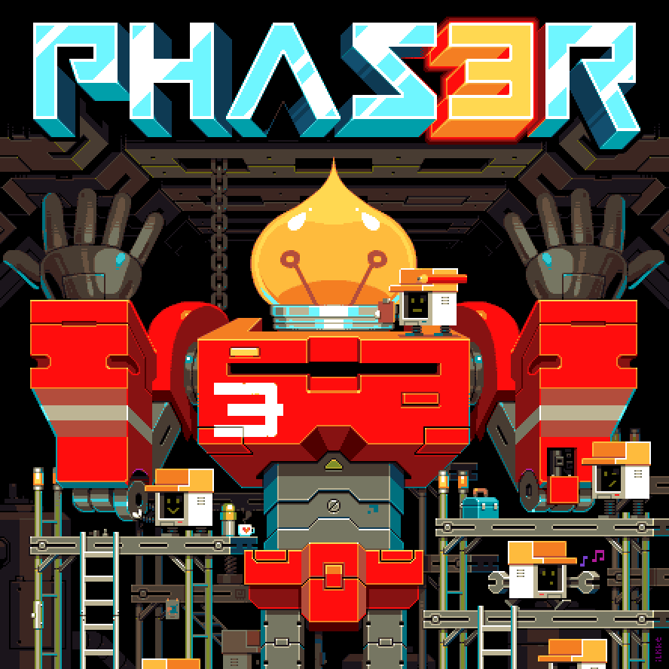
Web Games
with

Slide 2
Tower Defense
Scenes
Time vs Velocity
Overlays/Depth
Can set up multiple scenes (phase.scene) to swap through to allow for multiple screen like a selection scene and the game play
Originally the shapes traveled using time which lead to a speed issue, so setting up a path length made it easy to change it to velocity
Creating overlays to display information was easier than I originally expected using .setOrigin and .setDepth which also controlled the shapes and towers with simple numerical depths

Slide 3
Paintball Shooter
Physics System:
Arcade Physics (this.physics)
Collision detection (this.physics.add.collider)
Phaser also comes with MatterJS
Velocity-based movement (setVelocity, moveTo)
Group physics (staticGroup for walls, dynamic groups for bullets)
Allows the easy creation of actors (player, enemies) and the scripted movement of non-player actors through the physics system
with NextJS
Graphics and Rendering:
Basic shape drawing (circles, rectangles)
Hosted with Vercel
Deploy NextJS projects directly from GitHub
AI Logic
Made much easier to program actions based on movement, allowing enemies to react to seeing the player, losing sight of the player

Slide 4
Asteroid Shooter
Game Controls:
Movement: Controlled via arrow keys or keyboard input (rotate and move in 8 directions).
Shooting: The space bar fires lasers with physics-based trajectory.
Asteroids and Collisions: Asteroids are generated dynamically and destroyed on laser collision
Physics System:
(this.physics): Basic physics system to handle collision, gravity, and movement.
(this.physics.add.collider): Handles collisions between lasers and asteroids, and ensures objects don't move out of bounds.
LaserGroup Class: Manages laser projectiles using object pooling for efficiency (recycles lasers when they're no longer needed).
Graphics and Rendering:
Asset Management: Textures are preloaded using this.load.image for the player, laser, and asteroid.
Text Rendering: Score is displayed using this.add.text with styling to create clear, readable UI elements.

Slide 5
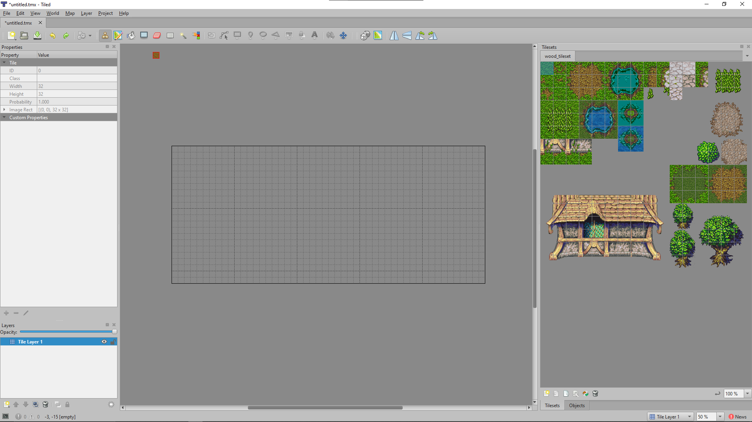
TILED w/ Phaser
Tool for sprite creation and level design
Pretty intuitive to build a 2d level, using layers and a click and place system for the imported sprites
Many options for sprites and animations online

